Slide 1
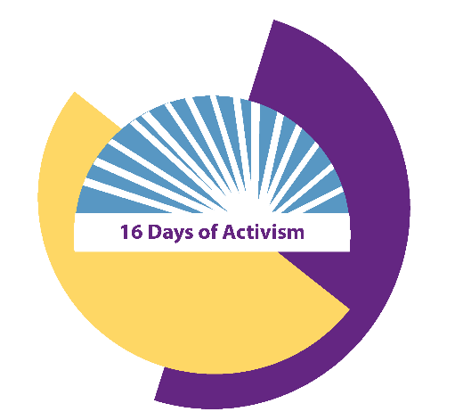
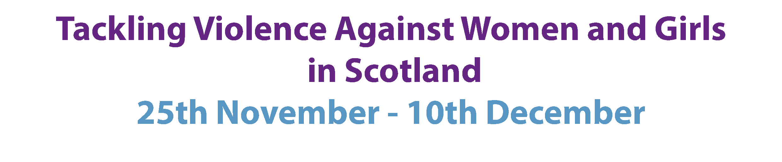
Imagine a Scotland without
gender-based violence
Type your idea here
#16Days

