Slide 1
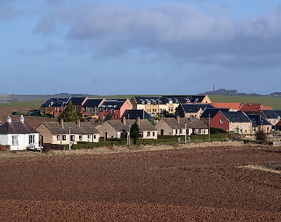
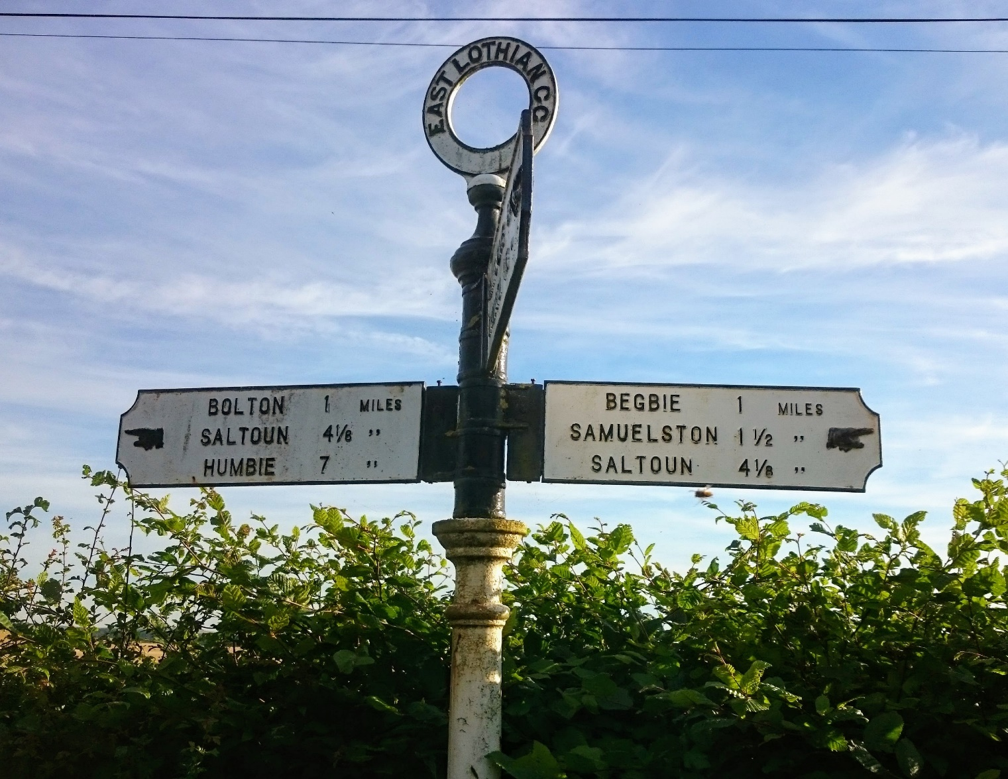
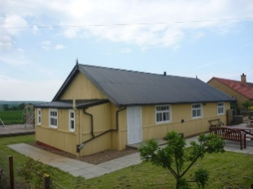
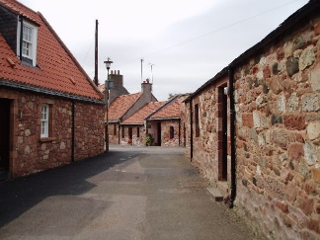
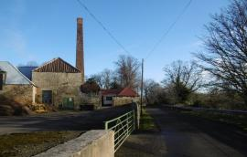
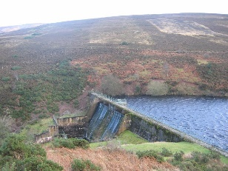
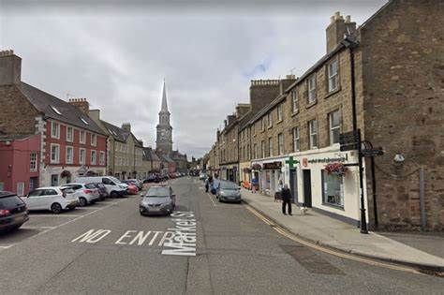
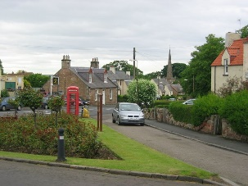
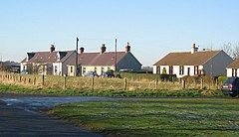
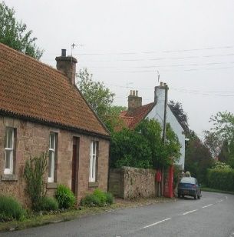
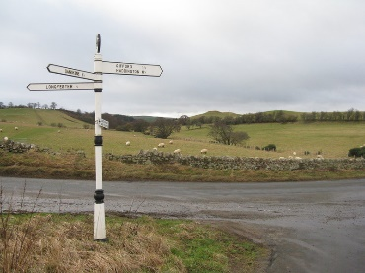
HADDINGTON & LAMMERMUIR AREA PARTNERSHIP
ANNUAL PUBLIC MEETING 23RD MAY 2023

Slide 2
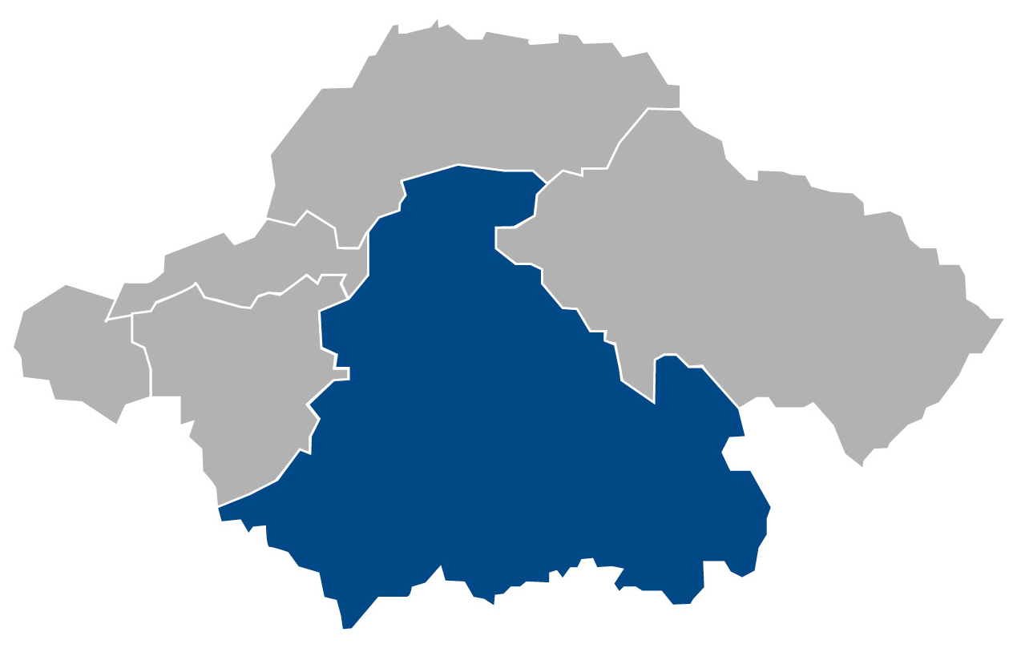
HALAP Annual Report 2021-2022
Welcome to our Annual Public Meeting and the opportunity to report on projects that have been funded during 2021 - 2022. Challenges have still been faced by the impact of COVID, it has continued to impact on all our lives, affected how we’ve felt and what we have been able to achieve. We have been able to fund 20 projects through our £50k general budget and also 5 more through an additional £18k funds allocated by the Scottish Government for food provision.
During 2021-2022 most, but not all of the projects have been able to complete during this time.

Slide 3
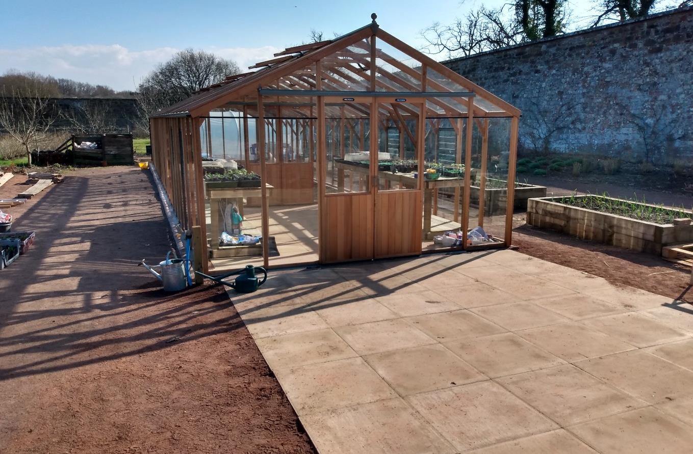
Amisfield Preservation Trust
Replacement of greenhouse.
The current greenhouse was at the end of its life and needed to be replaced. The greenhouse is a valuable feature of the garden and ensures that a range of plants can be grown.
Outcome 1
Provide a valuable space to allow volunteers and groups (including schools) to sow and propagate plants.
Outcome 2
Provide a space that is accessible to all including those with mobility issues.
Outcome 3
Deliver a safe structure that can be accessed by volunteers, members of the public, schools etc
Total cost of project £20,807
Awarded £5,000

Slide 4
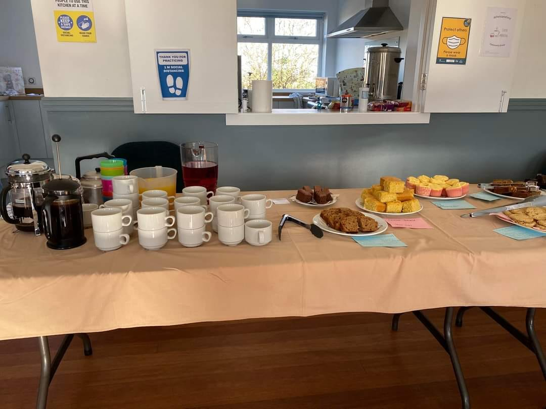
Athelstaneford Parish Hall
Reconnecting our community – a series of activities to bring the Athelstaneford community back together following the COVID restrictions of the last 2 years.
Outcome 1
Provide a series of social events to reduce social isolation of approximately 55 people in the village, including older residents.
Outcome 2
Provide a series of social events to support the emotional and social well-being of approximately 55 people in village by providing a space for shared experiences and learning
Awarded £560

Slide 5
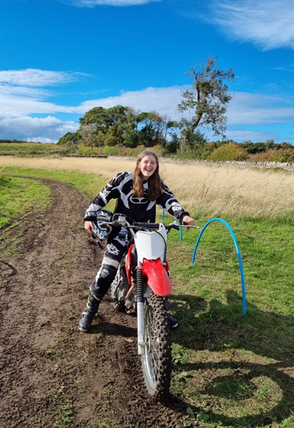
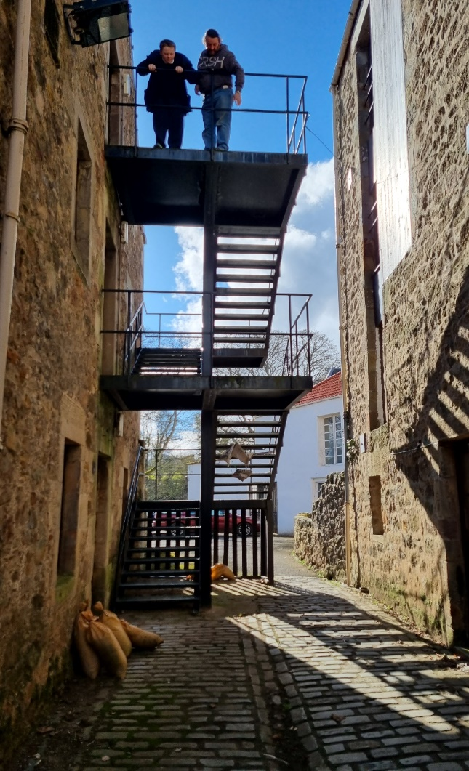
Bridge Centre Motorcycle Project
Outcome 1: 4 young people will participate in a 10-week programme at the Bridge Motorcycle Project which will improve relationships with peers, develop interpersonal and communication skills, and recognise the importance of team working.
Outcome 2: 5 young people will each attend 5 x one day, 1-2-1 sessions (25 individual sessions) which will help improve self confidence and self-esteem and increase motivation and higher personal aspirations.
BCMP staff will liaise with Meadowpark school staff who will identify individuals who are likely to benefit the most from participating in the proposed programme.
Awarded £11,589

Slide 6
The Haddington Bridge Centre Ltd
Let’s Play in our outdoor classroom – Garden equipment upgrade at Haddington Bridge Centre to allow for children’s development and skills to bloom.
Outcome 1 | To provide an outdoor classroom for circa 100 children per year
Outcome 2 | To provide upgraded outdoor equipment
Outcome 3 | For users to enjoy the peaceful garden space with seating
Awarded £4077.89
Summer trips for teens
Outcome 1 | Up to 20 targeted young people will access activities to improve social skills, problem solving and fitness.
Outcome 2 | Confidence will improve for those attending
Outcome 3 | Up to 20 young people will see wellbeing improved through sign posting to appropriate organisations.
Total cost of project £ 1397.68
Awarded £627.68

Slide 7
Saltoun Community Association (SCA)
Preparatory work (electrical re-fit & redecoration) and installation of lockable defibrillator in former telephone kiosk in East Saltoun.
Outcome 1
All local residents and visitors (including shop-users, walkers, cyclists etc) will have immediate access to a defibrillator in the event of anyone suffering sudden cardiac arrest. (Kiosk and defibrillator sited outside the village shop which is a central gathering point in the community.)
Outcome 2
Elderly, infirm and housebound residents will feel less isolated and maintain a higher level of confidence in their physical and mental wellbeing.
Outcome 3
Improved Life-saving Skills: Interested local residents will be trained in use of the new equipment after its installation by a local resident who is experienced in first aid and resuscitation.
Total cost of project £2285
Awarded £600

Slide 8
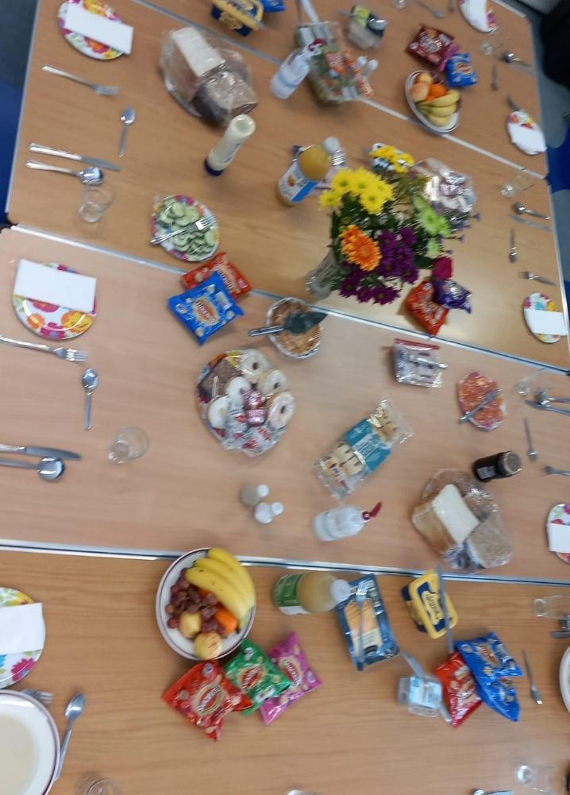
Friday Friends
Post-Covid Reopening of Friday Friends Sessions and Supportive Services
Outcome 1: Service users will have access to good nutrition, creative and supportive activities, and opportunities to re-connect and re-socialise with others after lengthy periods of covid-induced social isolation.
Outcome 2: Service users will have access to safe and confidential counselling and support which will contribute to improved wellbeing and reduction of anxiety, stress and depression.
Outcome 3: Re-engage community back into access of the N&HCC by way of weekly counselling sessions availability and bookings for use of the venue.
Awarded £2483
Awarded a further £1500

Slide 9
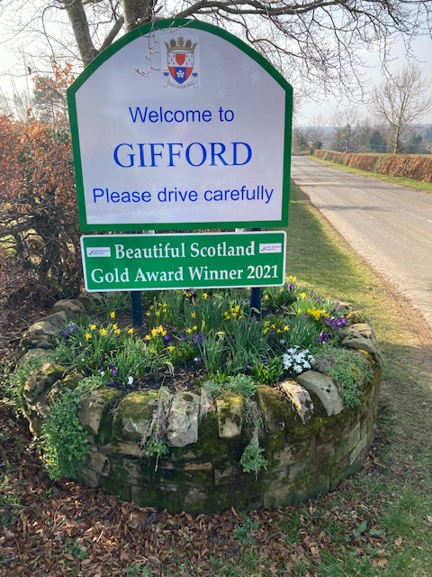
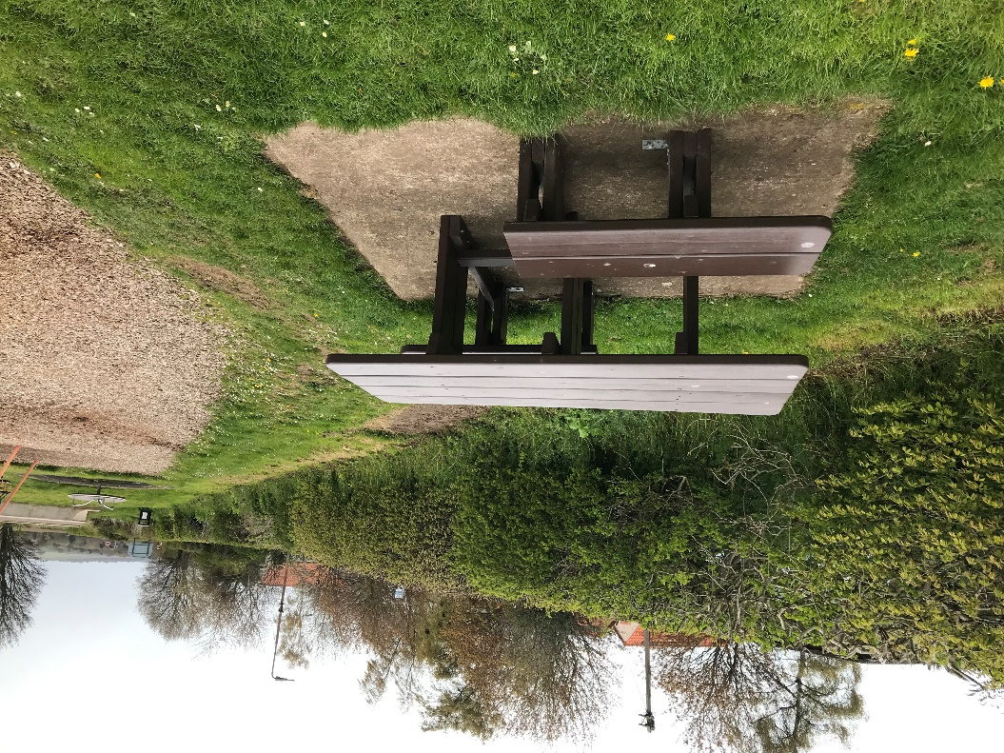
Community Council’s
Gifford Community Council
Promote the success of the gold awards for the village from Keep Scotland Beautiful through appropriate signage
£880.50 awarded to roads dept to carry out signage.
Haddington & District Community Council
Replacement of 2 picnic tables and 2 benches* at the main play park in Athelstaneford village.
Funding awarded to Amenities Services £1500 and £1429

Slide 10
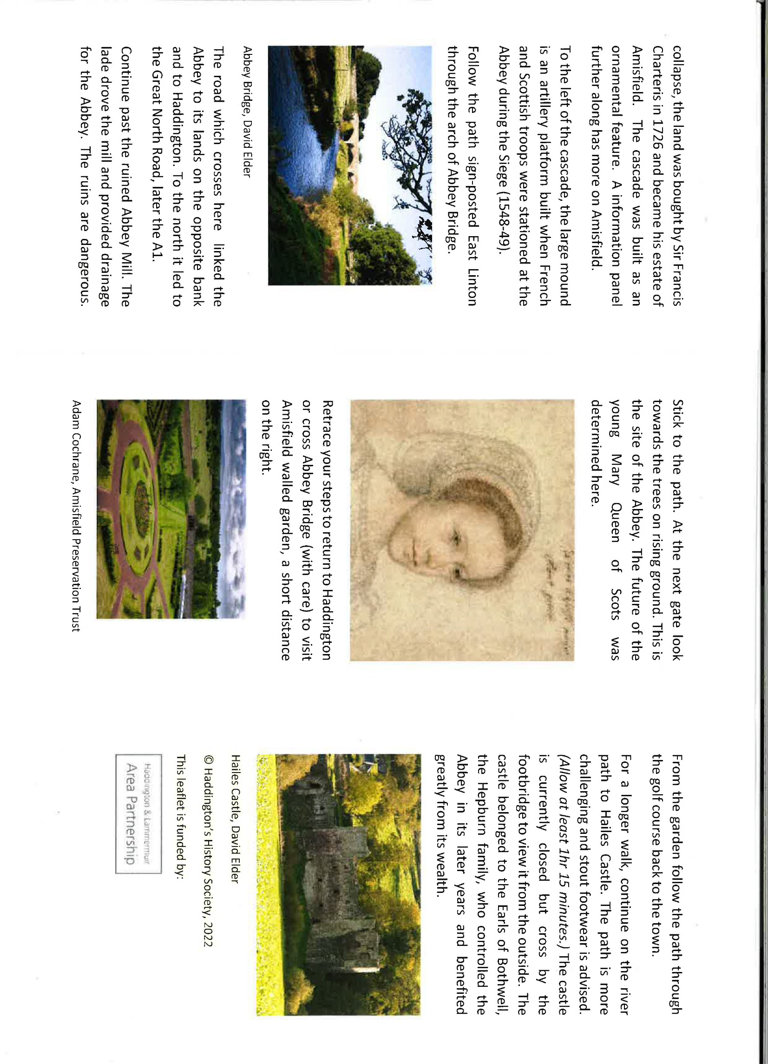
Haddington History Society
Creation of an information panel on the site of the Abbey of St Mary, Haddington. Creation of an Abbey Trail guide for walkers linking sites associated with the Abbey.
Outcome 1: A better understanding and appreciation of Haddington’s heritage.
Outcome 2: Greater use of the Tyne core path with consequent health benefits.
Outcome 3: Increased footfall in local eating places.
Total project costs £ 2586.28
Awarded £750

Slide 11
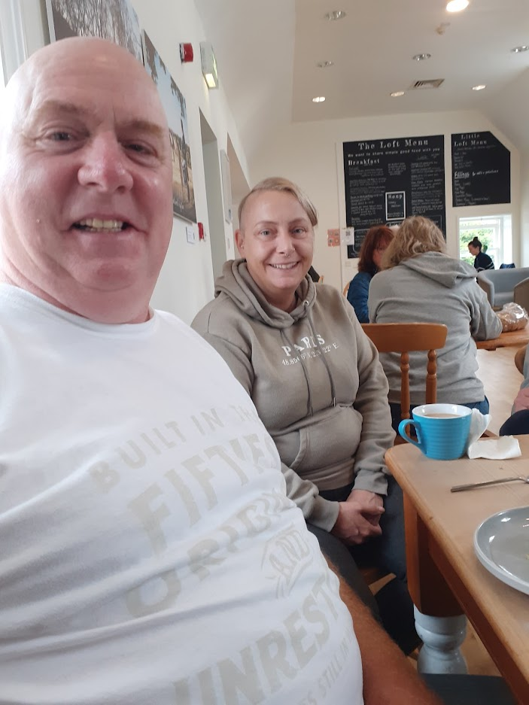
Haddington East TRA-Mental Health Peer
HETRA - Mental Health Peer Support Group – ‘Buddying and Group meet up’
Outcome 1: Reduction of loneliness and isolation
Outcome 2: Peer Support/socialising
Outcome 3: Removed financial barriers to social interactions
Awarded £2000 and a further £1500

Slide 12
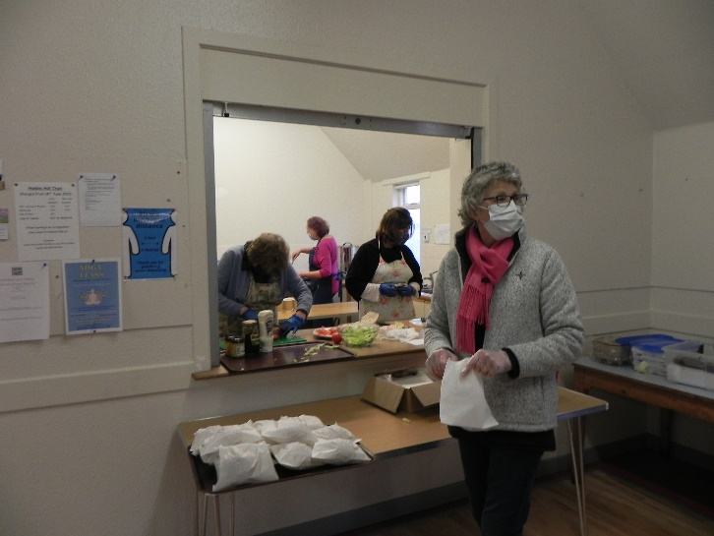
Humbie, West & East Saltoun and Bolton Community Council – ‘Humbiehelp’ Resilience Group
Soupersnack lunches extend to April
Outcome 1: Twenty-two residents meet on a fortnightly basis, in the village hall, this reduces their social isolation and is part of a ‘trip out’ to the village hall.
Outcome 2: Volunteers mix with residents allowing access to stimulating conversation.
Outcome 3: A tasty homemade lunch is available, either eaten in the hall or delivered to their home.
Awarded £450

Slide 13
Keep the Heid Mental Health Cafe
Keep The Heid is a safe place to share experiences of living with mental health problems for residents of Haddington and the surrounding area.
Outcome 1: People will have the opportunity to improve their mental health by sharing experiences with others in similar situations.
Outcome 2: People will have the opportunity to meet others in their community experiencing similar issues.
Outcome 3: People will become more resilient and develop coping strategies for improving their mental health.
Awarded £1100

Slide 14
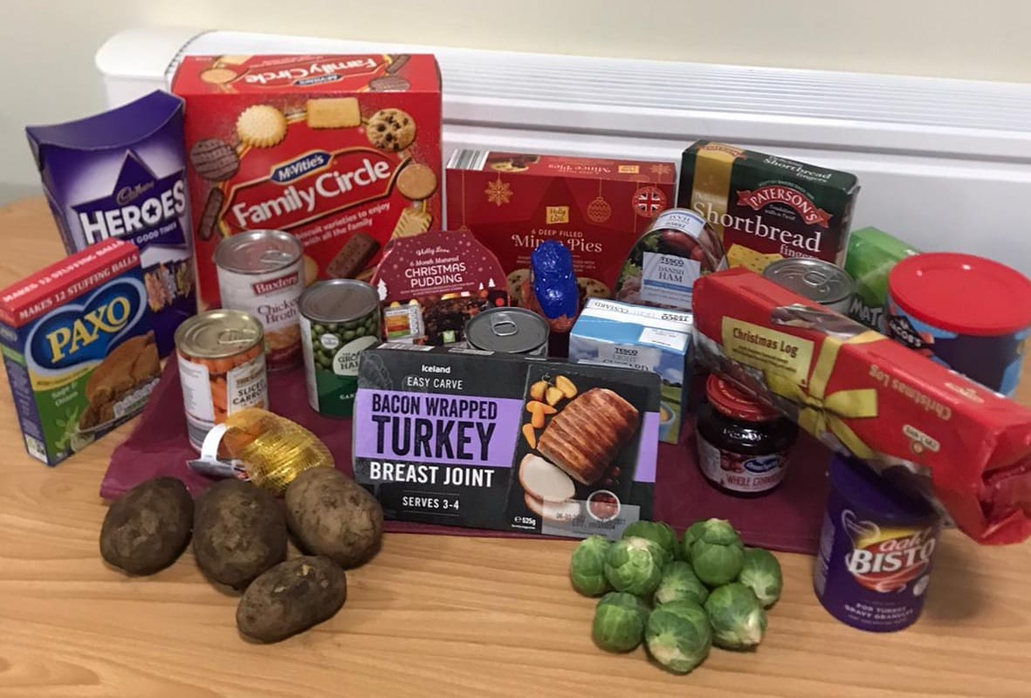
The Lammermuir Larder Group
Costs involved in moving to permanent premises and the running costs for the next year.
Outcome 1: By having more accessible and permanent premises, the Larder will be able to grow and offer more services to the people of this ward, including small food workshops following the pandemic.
Outcome 2: More people will be able to access emergency food by dropping in to the new premises and picking up what they need.
Outcome 3: As we have a private meeting room, we will be able to offer 1:1 welfare benefit advice to people in this ward.
Awarded £3390.88

Slide 15
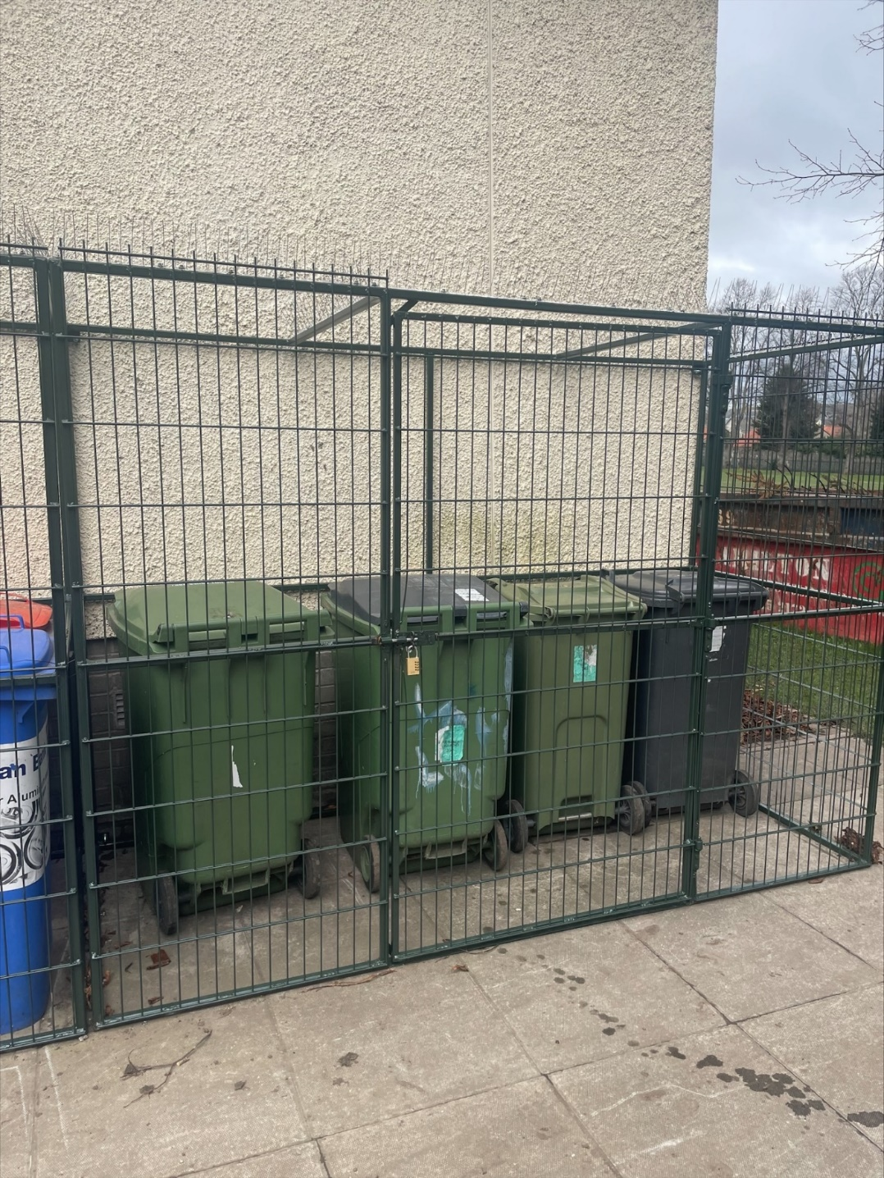
Haddington RFC
Funding to support a new fence to prevent anti social behaviour at HRFC.
The outcomes we are looking to achieve:
Permanent protection to the bin store area with c10 waste bins of waste including glass bottles.
Permanent protection to out of hours access the fire escape
Double gate access will allow access to the bins and rugby kit stores
Double gate access will allow the gates to be unlocked when the clubhouse is in use
Reduce anti social behaviour with a direct impact on Police time taken up in investigating antisocial behaviour
Increase protection to HRFC clubhouse and protecting a well utilised community facility.
Total cost of project £5220
Awarded £2610

Slide 16
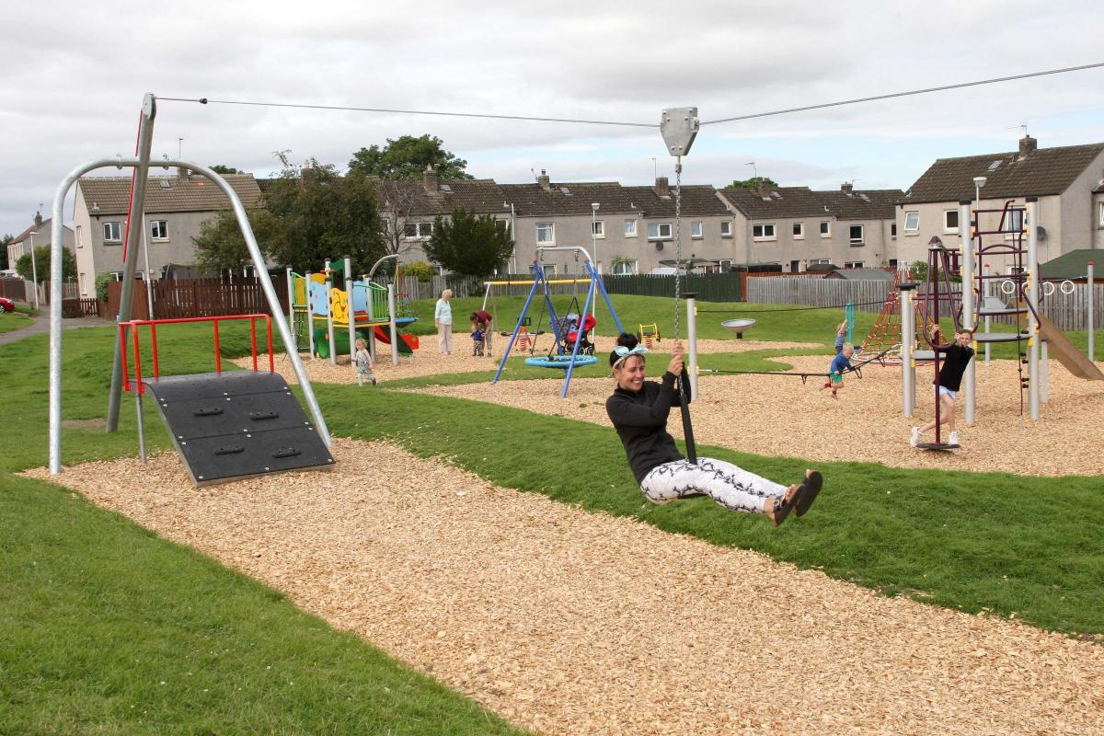
HETRA and other residents
Cllr Craig Hoy on behalf of the residents around the area
2 x public refuse bins for railway walk area
Outcome 1: Improve local amenity to ensure area looks vibrant and appealing
Outcome 2: Resolve litter problem
Outcome 3: Improve health and wellbeing
Awarded £800 to Amenities Services for purchase and installation.
Haddington East Tenants & Residents Group
To complete the upgrading of Seggarsdean park with additional items of two benches*, two picnic tables and two bins.
Awarded £4071.89 to Amenities Services

Slide 17
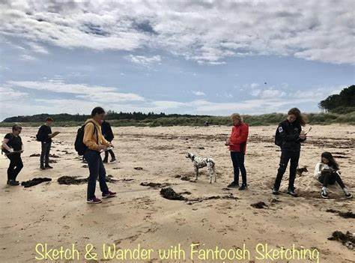
Sketch and Wander for wellbeing
Outcome 1: To offer creative workshops in self expression which connect people to nature, themselves and each other.
Outcome 2: To help people connect both to their communities and to where they live
Outcome 3: Share and promote the process that making art in nature brings to people’s wellbeing whether alone or/ and together
Outcome 4: Bringing folk together through creative happenings, based mainly outside and around nature
Awarded £2400

Slide 18
Support from the Start
Early Years Covid Recovery Project for Haddington and Lammermuir
Outcome 1: To promote the importance of the early years of life for health and well-being.
Outcome 2: To support children and their parents to access the support they need to thrive.
Outcome 3: To support community and agencies and community members to work together and identify local priorities for early years.
Awarded £20,000

Slide 19
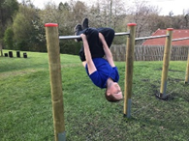
Yester Primary School Parent Council
“Playground Pals” – Extension to current school outdoor play equipment.
Yester pupils have asked for additional outdoor play equipment, specifically for an extension to the current “trim trail”.
Outcome 1: Improve the wellbeing of Yester pupils by providing more opportunities for outdoor play
Outcome 2: Extended playground facilities will give more children access to outdoor play equipment at one time. The community will also benefit from this as the school grounds are always accessible.
Outcome 3: Provide opportunities for children to ‘risk take’ with their play in a safe and controlled environment.
£1585 total cost of project
Awarded £585

Slide 20
MADE in East Lothian
Haddington 2020 – the Year of the goat.
Outcome 1: Provide a series of cumulative workshops and outreach projects in Haddington to celebrate and promote the town and its heritage. The 2020 vision will use the town emblem of the goat to create a series of works and artefacts in collaboration with local people of all ages that interpret the town mascot and its significance.
Outcome 2: Deliver a community engagement project exploring the towns history and heritage whilst learning and developing both creative and practical skills.
Awarded £4650 in 2020, completed later due to the pandemic

Slide 21
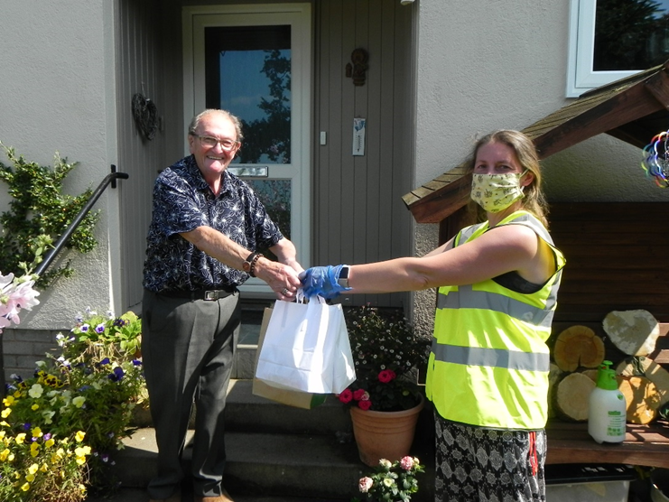
Scottish Government COVID Related Funding 2021-2022
During 2021-2022 Haddington and Lammermuir Area partnership received approx. £18,000 additional Scottish Government funding to support local communities response to food related need during the pandemic. This enabled the partnership to support the following projects:
Haddington Day Centre to address isolation by providing Christmas lunches, £500.
Haddstock CIC post pandemic adaptations, £1000.
Humbie East & West Saltoun and Bolton CC to continue providing Soupersnack lunches, £1250.
Lammermuir Larder to supply essential items for mothers with infants and children under three and associated costs with moving into new premises, £2136.20
Our Community Kitchen received funding to support local community response to COVID19 related food need, £13,117.34

Slide 22
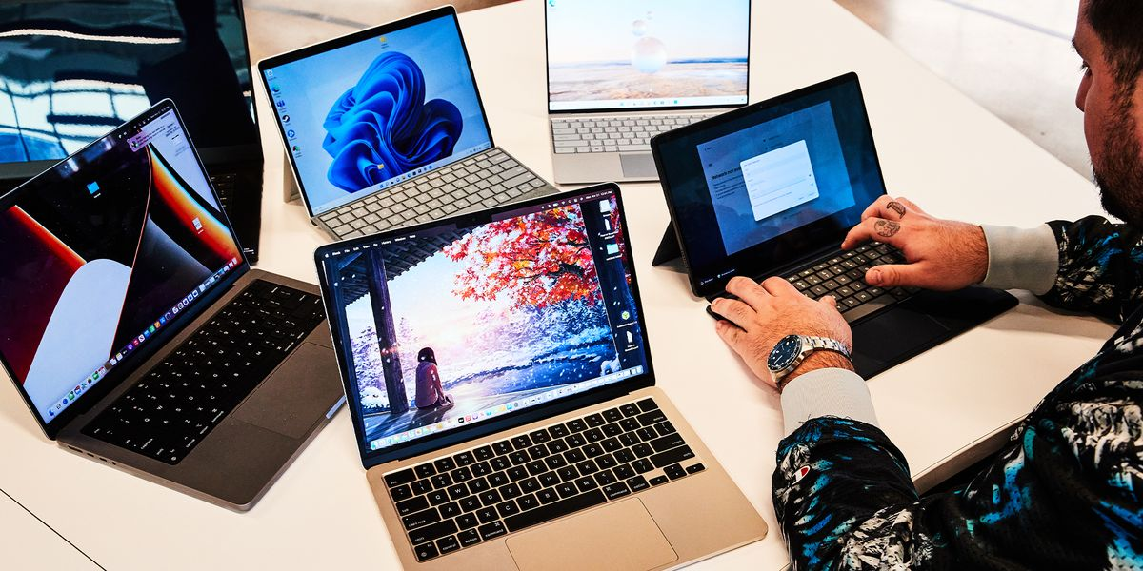
Scottish Government IT funding
Helping Haddington and the Lammermuir area become digitally inclusive
Outcome 1: Four laptops available for community group hire Outcome 2: Six zoom licences purchased for various community groups to use Outcome 3: Users of Haddington Bridge Centre able to access Wi-Fi throughout the building (approx. 250 users weekly). Awarded £3630.17

Slide 23
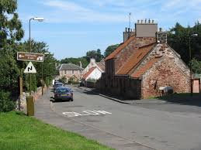
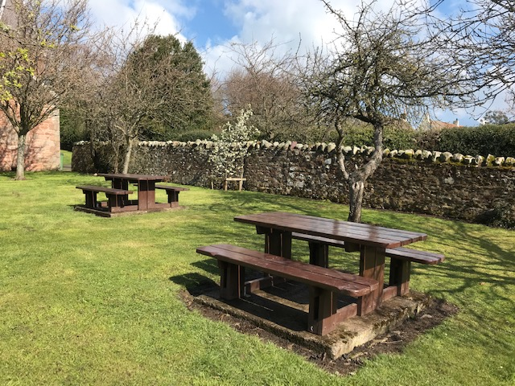
Roads & Amenities Budgets 2021-2022
ELC Roads and Amenity Teams have been impacted by reduced staffing levels, in particular the Amenities services. Work has often been restricted to delivering essential services.
During 2021-2022 the area partnership have funded a number of amenities projects, some have been completed but others are outstanding. Benches are on order for Seggarsdean and Athelstaneford parks with works due to be completed by autumn 2023.

Slide 24
Thank You
Finally a huge thank you to all the staff, volunteers, community groups and organisations who continue to support our communities.
Together we do achieve more as we strive to make the biggest difference to lives and our communities.
We are still feeling the effects of having lived through a pandemic, issues have been exacerbated which are now coupled with the impact of the cost of living crisis.
The coming year will continue to be challenging and will be a big ask of staff and volunteers.
The area partnership’s role continues to work together to address local priorities of reducing poverty and closing the inequality gap.
If you would like to find out more about the Area Partnership please drop us an email at:
handl-ap@eastlothian.gov.uk

