Slide 1
£42,000 of Scottish Government Food Fund money was distributed through the PSG Area Partnership.
Pennypit Trust delivered 20,000 meals & received £3,000 for hardship funds
Heavy Sounds delivered 90,000 lunches across Edinburgh and the Lothians, along food shopping and gas meter top up support
Prestonpans Community Council Resilience Team undertook 565 jobs for local residents shopping, dog walking, gardening and other support

Slide 2
Longniddry Parish Church Resilience Team undertook support 71 shops with 36 volunteers for 17 people number of people with shopping
Cockenzie and Port Seton Resilience Team delivered 16,622 meals and managed £3,000 of hardship funds and £6,150 recipe pack funds. They received 234 phone calls for support for shopping, prescriptions and other support.
PSG CLD Team set up and supported the East Lothian Fareshare Hub over the last year with 1,592 hours of staff time, 381 pick ups/deliveries to 20 organisations in East Lothian and received 122 van loads of food from Fareshare
£10,500 of funding Business Recovery funding secured for PSG Shop Local, Support your High Street Reward Scheme beginning 17th May

Slide 3
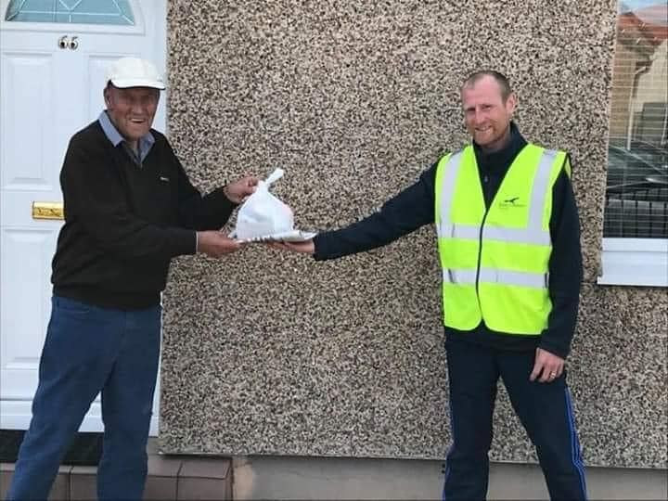
Beyond COVID
The Legacy projects
Pennypit Trust befriending project supporting 20 people and meals on wheels providing 120 meals a week.
CPS Community Council & Port Seton Centre meals on wheels (22 meals twice a week since September) and brew and blether sessions beginning next week in café

