Slide 1
20/21 Project Funding

Slide 2
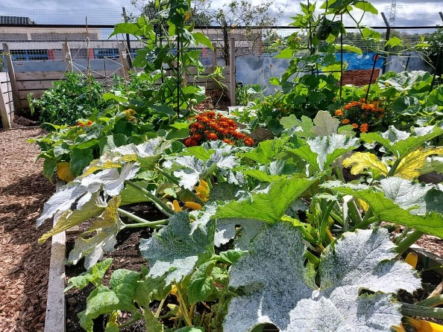
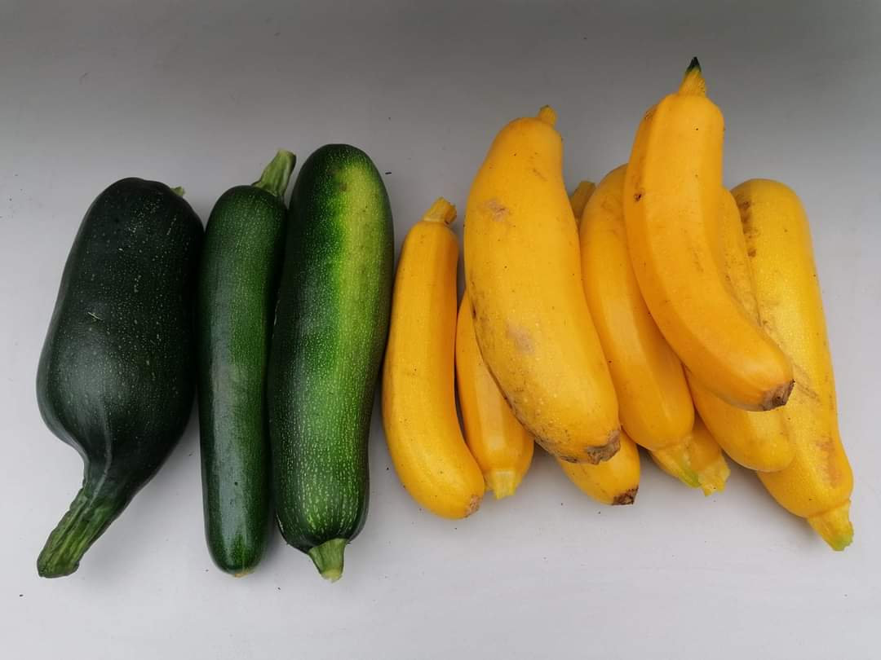
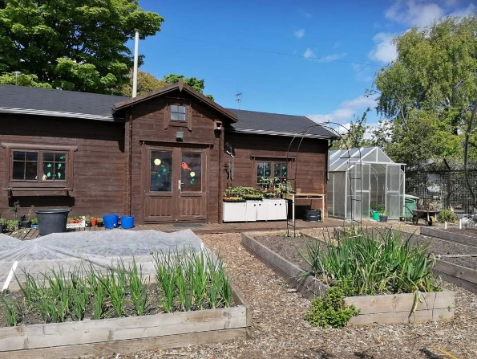
Seed to Plate – CPS in Bloom
Amount: £4,687.50
What was achieved?
Our initial plan has been modified to meet the challenges of the pandemic.
In late Autumn, we harvested the remaining fruit and vegetables and distributed them locally. This included giving 18 pumpkins to the Primary School at Hallowe’en, together with colourful leaflets with 3 recipes using the pumpkin flesh – a soup, a main course and a sweet – thus creating cheap, tasty and nutritious meals.
Recipe book has been created

Slide 3
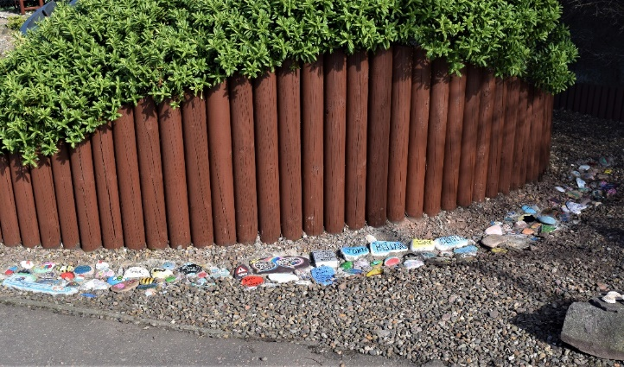
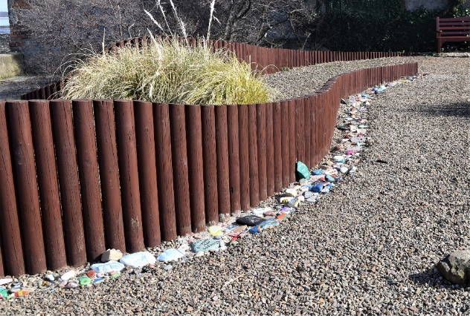
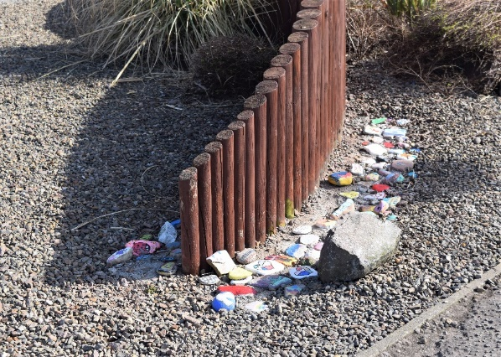
CPS - Rainbow Snake
Amount: £250
What was achieved?
We were successful in completing the project as planned but we still have extra remedial work to carry out.
We varnished the stones prior to setting them in postcrete but some have weathered after a short time. To overcome this problem the stones will be covered in a resin.

Slide 4
Active Schools
Amount: £2,000
What was Achieved?
Sports Bursary Scheme unable to launch due to COVID 19 will be soon
Preparing the application process which will follow a streamlined and coordinated approach across East Lothian
In discussion with Walk With Scott Foundation re support
Preparing to launch an equipment swap shop
Establishing connections with local sports shops in East Lothian

Slide 5
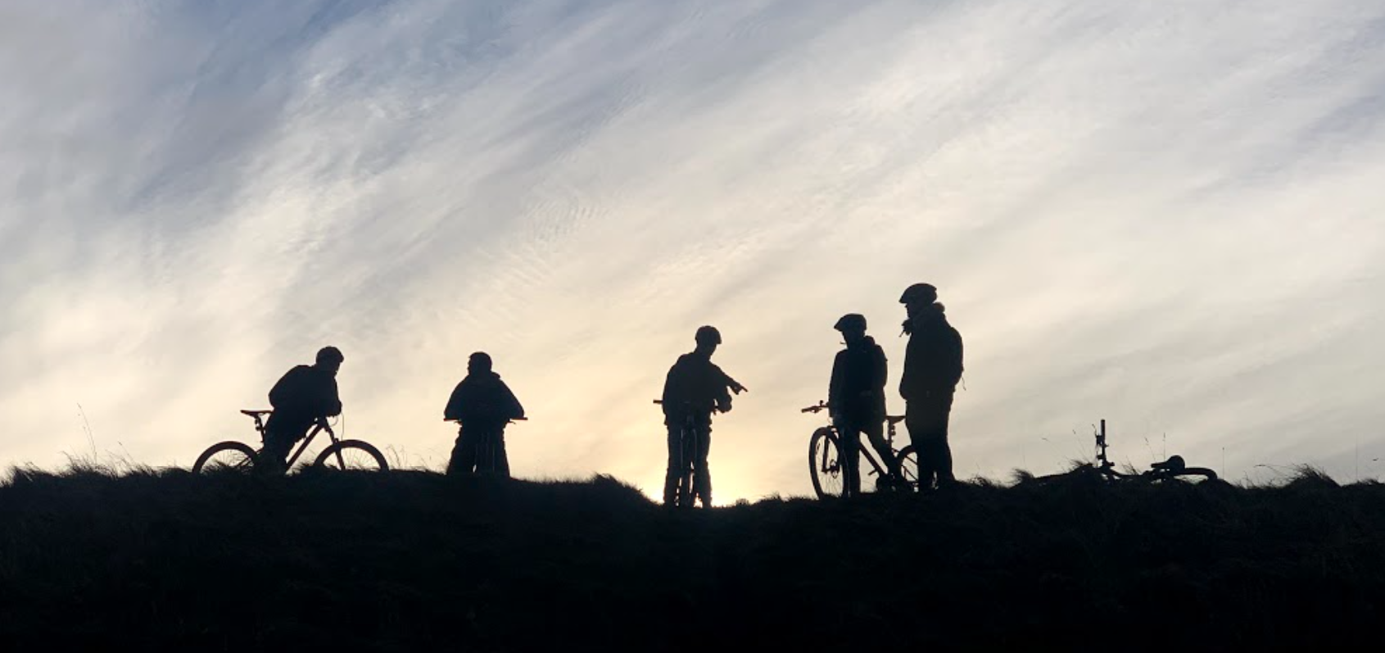
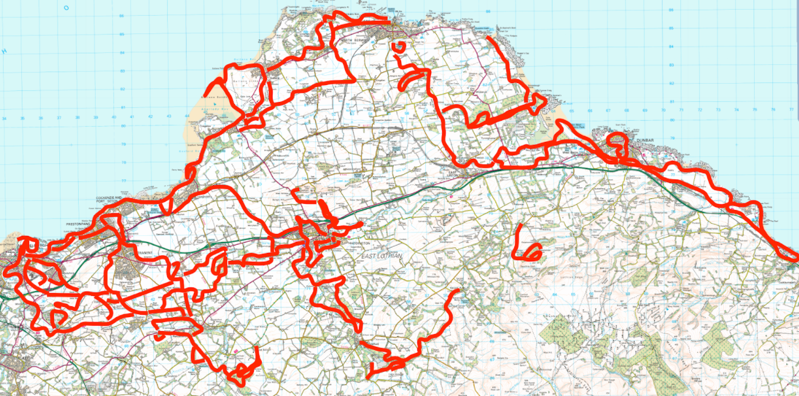
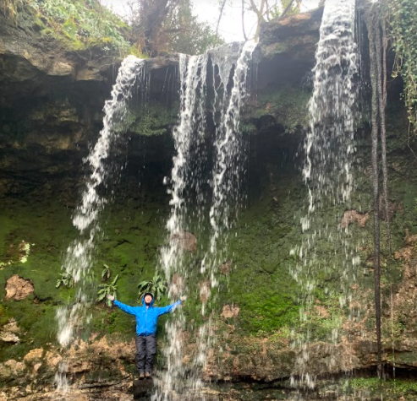
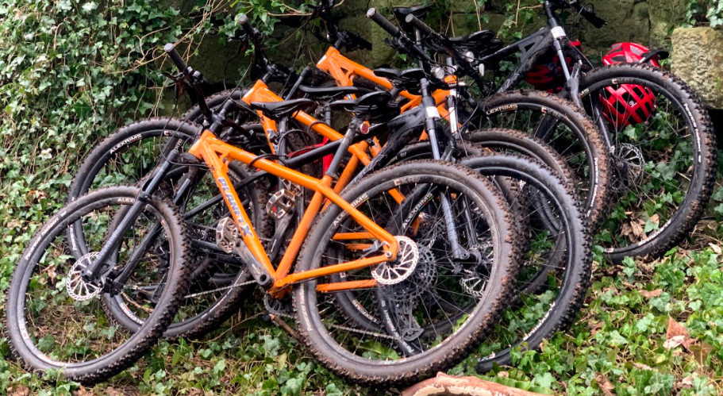
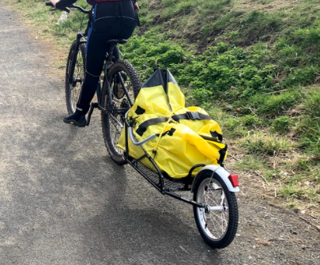
Biking North
Amount: £1,110
What was Achieved?
Biking equipment purchased
Routes explored

Slide 6
Mental Health Youth Worker - Preston Lodge HS
Amount: £35,000 (19/20 Educational attainment budget but delay on recruiting)
What was achieved?
Recruited Pupil Support Worker – Mental Health – Catherine Cerbauskas
Helping with inclusion one day a week
Working in and out of classes
Looking at attendance (longer term)
Having morning check ins
Admin/support allocation and attendance for group work taking place (Venturing Out)

Slide 7
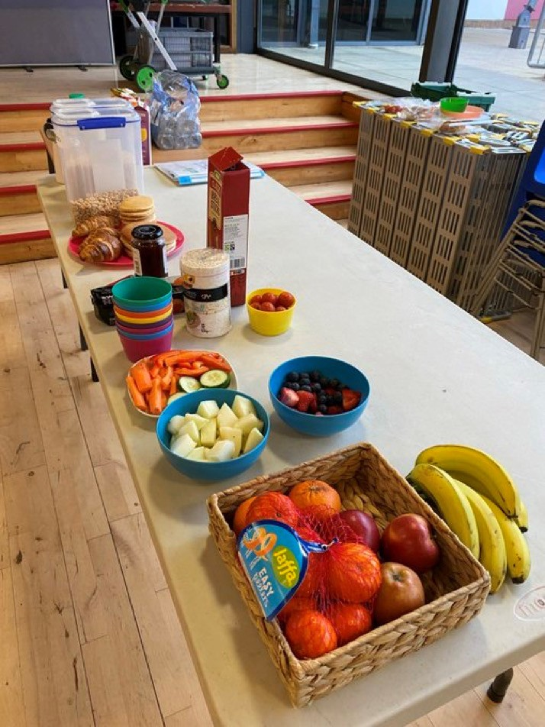
Preston Lodge Breakfast Café
Amount: £4,250
What was achieved?
Breakfast café has continued during the pandemic
Challenges due to COVID in terms of space, training, involving external volunteers
On students returning to school after Easter, we have had an average of 70 pupils having breakfast each week.
Jonathan Sharples from the Penny Pit Trust is providing nutritional advice and running the breakfast café service each day, alongside PL staff rota who are volunteering their time.

Slide 8
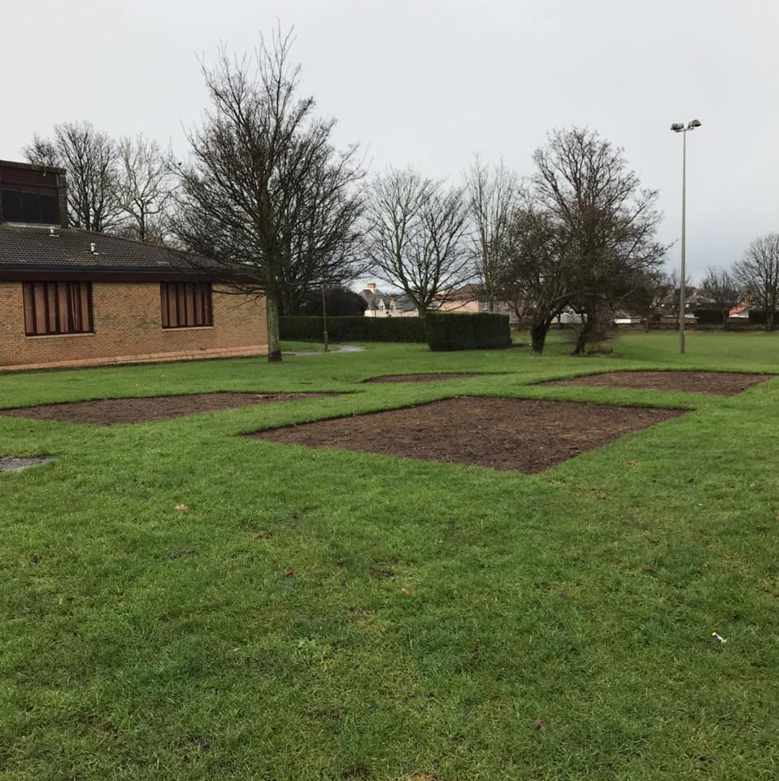
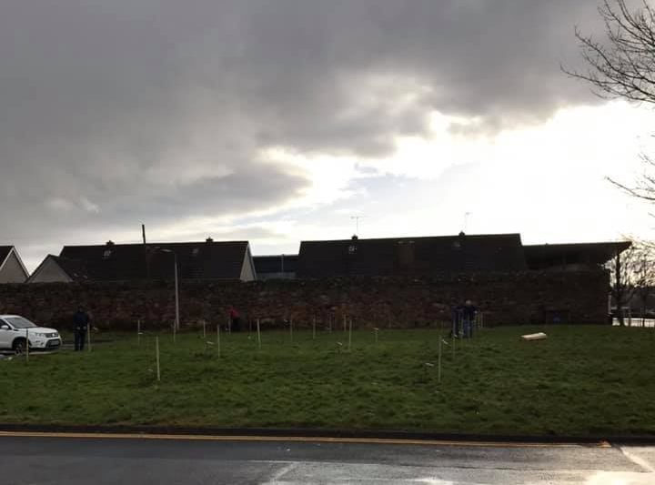
Pots and Pans – Renamed Prestonpans Bloomers
Amount £4,000
What has been achieved?
Delayed due to COVID
4 large beds have been prepared between the community centre and surgery
28 Heritage Apple trees and bulbs have been planted at entrance next to surgery
Management Committee forming
Raised beds, paths and gates etc. to be installed

Slide 9
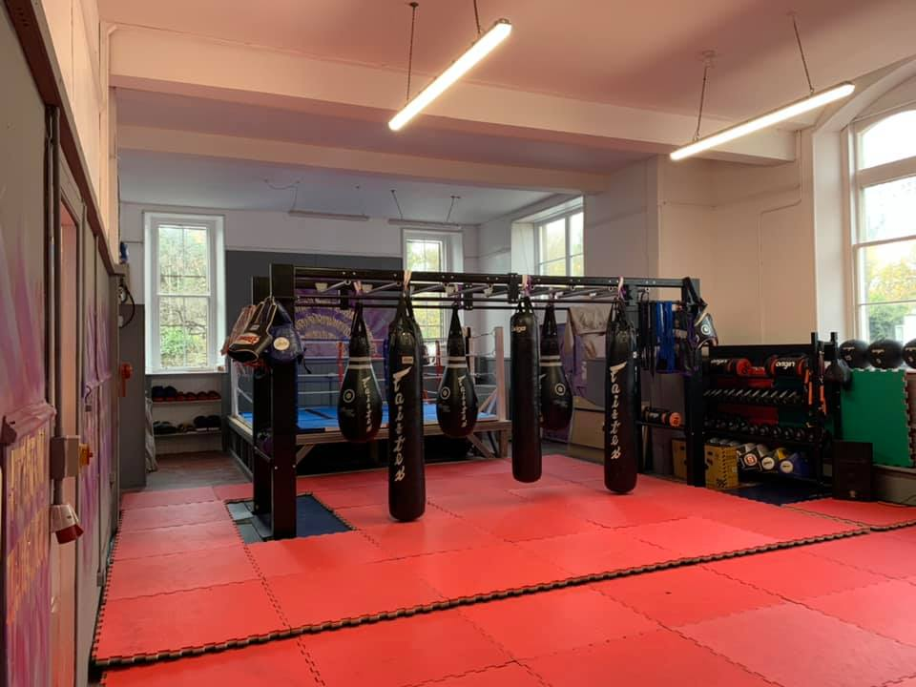
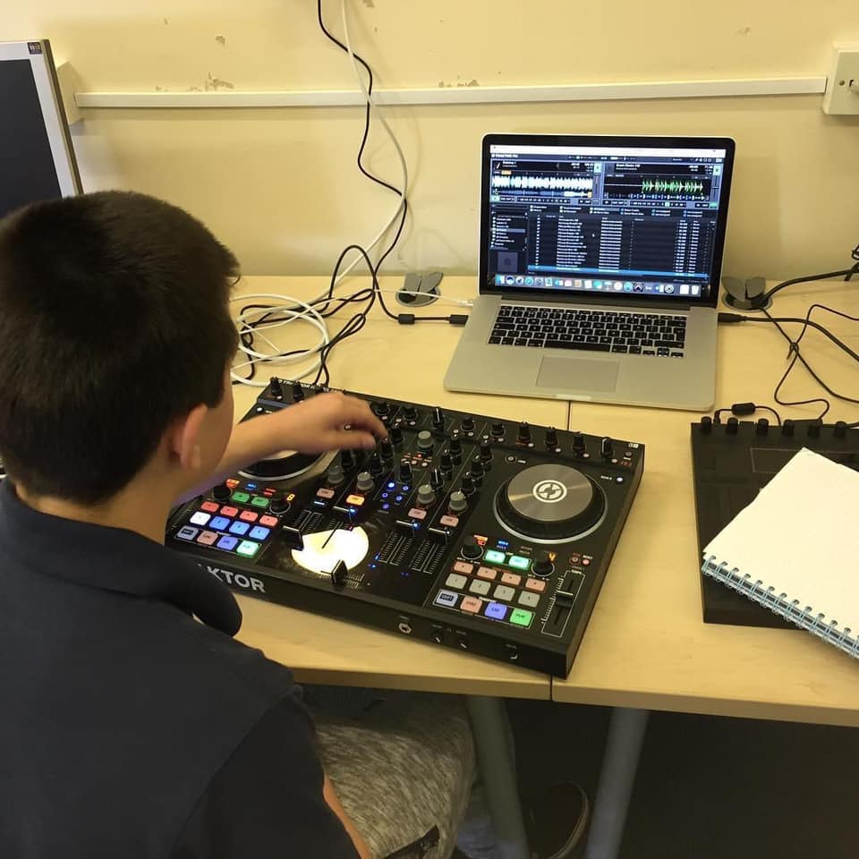
Heavy Sounds
Amount: £5,320
What has been achieved?
Sessions have been delayed in starting due to COVID
10 young people have been identified to engage in divisionary activity with police/school
Two sessions a week – Friday Evenings
Mui Thai boxing available

Slide 10
Lighthouse CAP Debt Service
Amount: £1,670
What has been achieved?
Enabled the centre to remain open and support 9 new client families 16 people
Process took longer to assist due to lack of face to face meetings, access to computers and printers for clients.

Slide 11
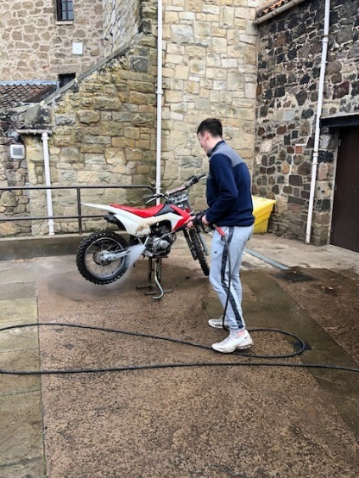
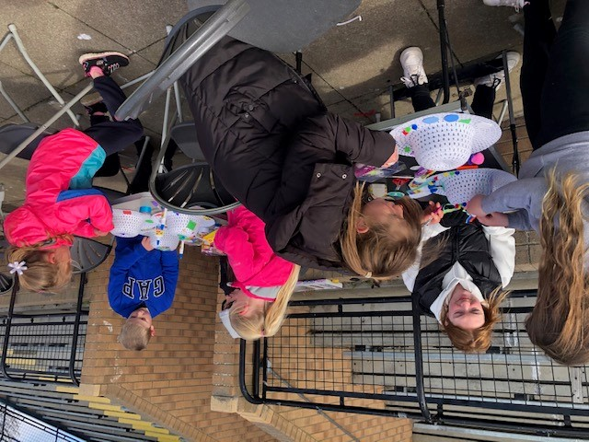
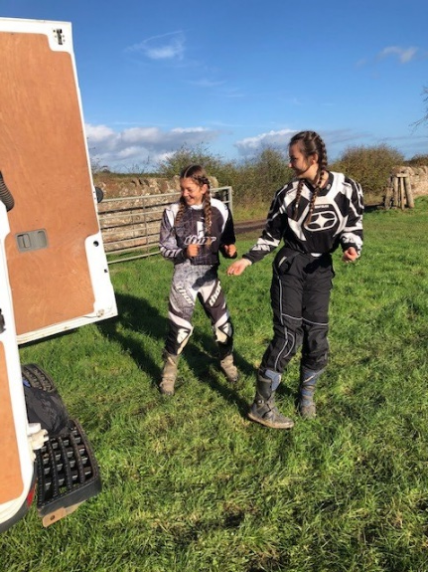
Pennypit Trust
Amount: £12,963.75
What has been achieved?
10 young people have been supported one to one through family support service
6 young people have accessed the Pennypit Outdoor Pursuits programme in partnership through Preston Lodge HS
Supporting volunteers particularly during COVID response has been a key part of work
7 young people have been supported through home work club
20 children and young people have accessed the Friday Night Youth Club

Slide 12
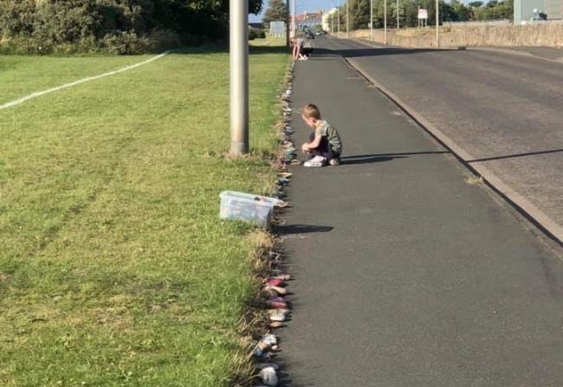
Prestonpans Snake
Amount: £250
What was achieved?
Area agreed for laying stones to west of Cockenzie site
People have been asked to collect stones to repaint and varnish
Amenities will assist with laying stones and setting in resin

Slide 13
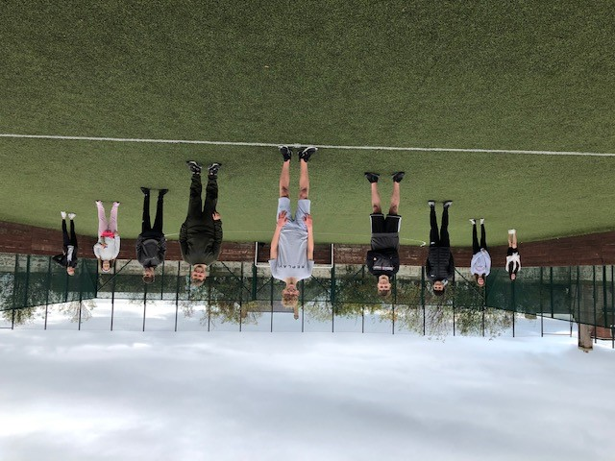
PSG Youth Forum
Amount: £4,020.16
What was achieved?
A couple of meetings have taken place with young people through Pennypit, but delayed bringing young people together due to COVID
To be relaunched with young people from each area who will feed into the AP when youth work can restart

Slide 14
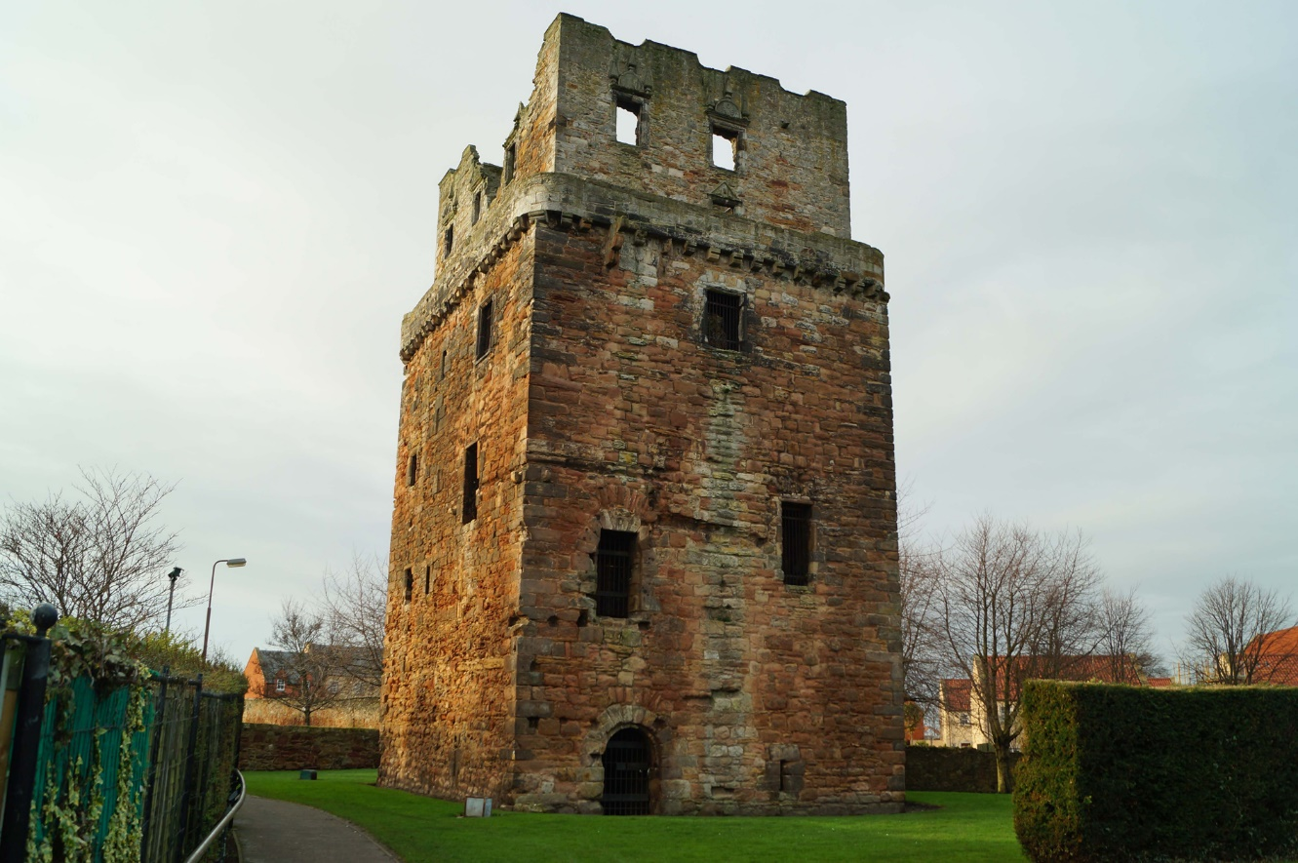
Preston Tower
Amount: £500
What was achieved?
Additional survey work undertaken to look to reinstate an external staircase

Slide 15
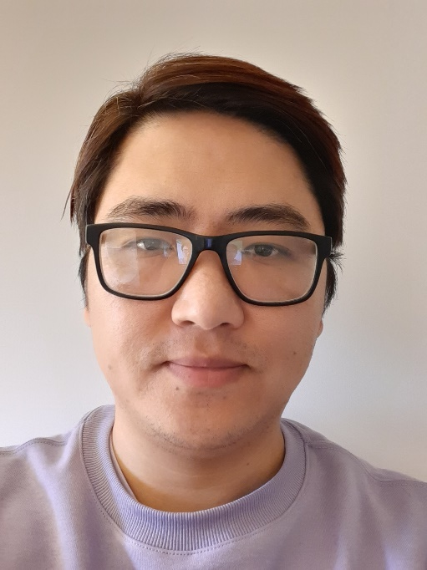
Link Worker – We are with you
Amount £2,800
What has been achieved?
Allocated funding through H & W subgroup for supporting roles
in March 2021
Link Workers started in January 2021 – Sam based in Prestonpans Surgery; Harbours position has been recruited starts in 2 weeks
30 clients; 11 successful discharge and 3 not engaged
Funding to support their activities and support has included; buying basic phones, vouchers for emergency food so far

Slide 16
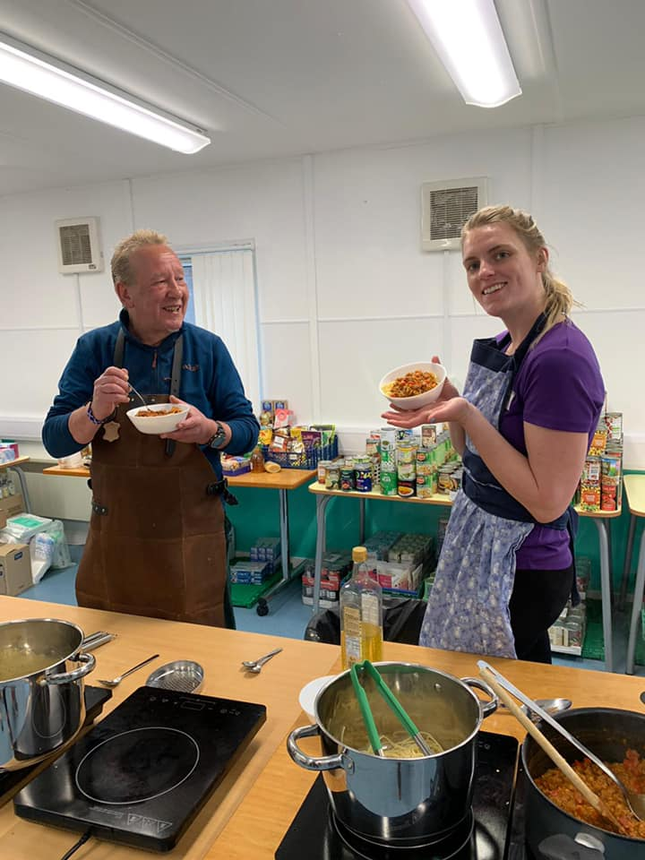
Supporting Nutritional Inequalities– Pennypit Trust
Amount: £2,500
What has been achieved?
Allocated funding through H & W subgroup in March 2021
Cook-Along with Carrie packs - 30 per week
Online Weaning sessions – 34 people attended
Investigating buggy walks with Scottish Buggy Clubs

Slide 17
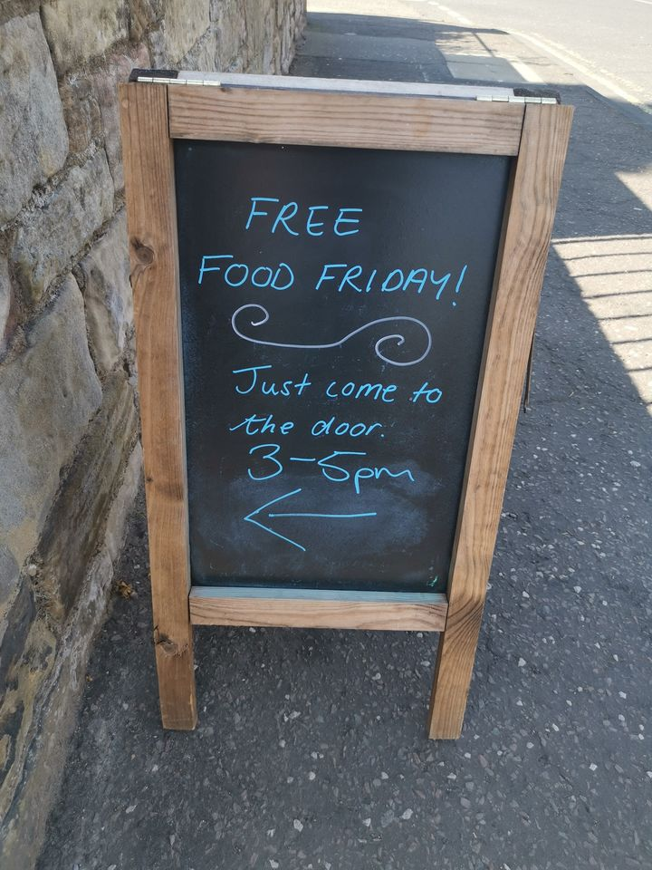
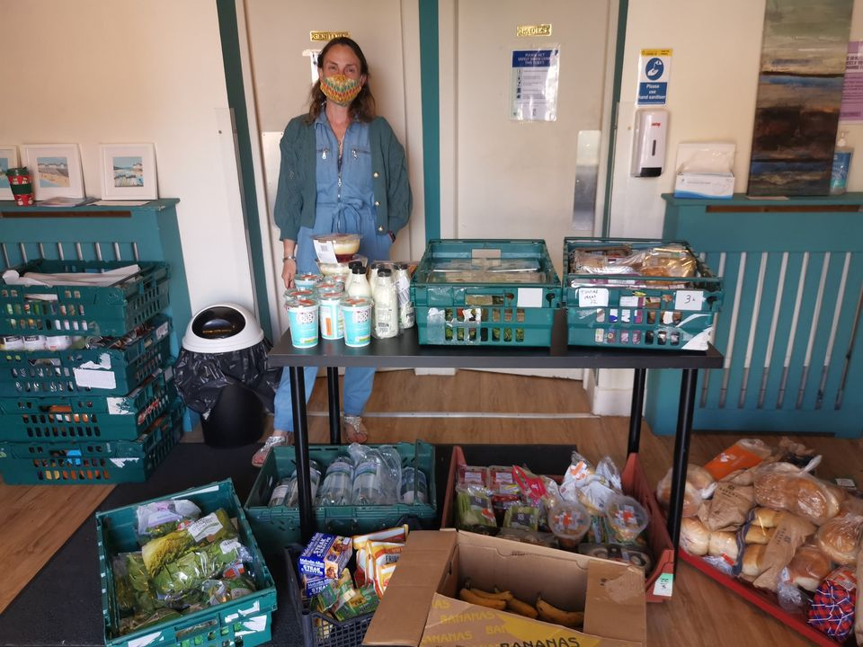
Lighthouse Foodbank +
Amount: £500
What has been achieved?
Allocated funding through H & W subgroup in March 2021
Open every Monday 10.30-12.30am through referral and free food Friday operates 3-5pm by drop in
33 households at the Foodbank (that's 46 adults/teenagers and 10 under 12s on average for 6 weeks
There is flexibility but generally people can access 2 x 6 weekly blocks within 6 months.
Funding will assist with topping up items from donations and fareshare, tea and coffee for clients, storage and shelving, covid cleaning products, hand sanitiser and masks, producing leaflets and posters which we hope to distribute locally soon.

Slide 18
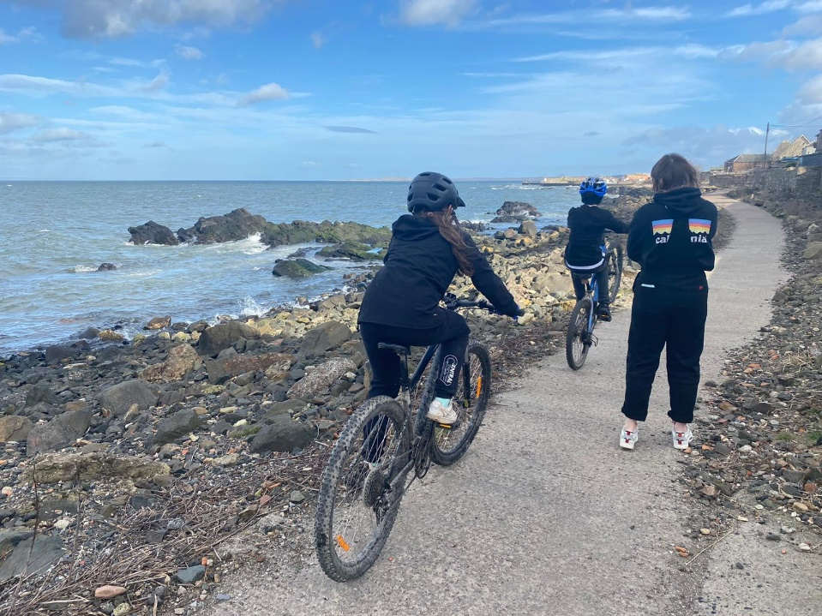
Bike Project – Preston Lodge and Pennypit Trust
Amount £2,800
What has been achieved?
Allocated funding through H & Wellbeing Sub group in March 2021
The bike project has worked with 10 pupils
They fix up broken bikes, learn about bike maintenance, problem solving, how to follow instructions and bike safety.
The funding supported a local person to run classes with in school
Looking to add an SVQ in the future.

Slide 19
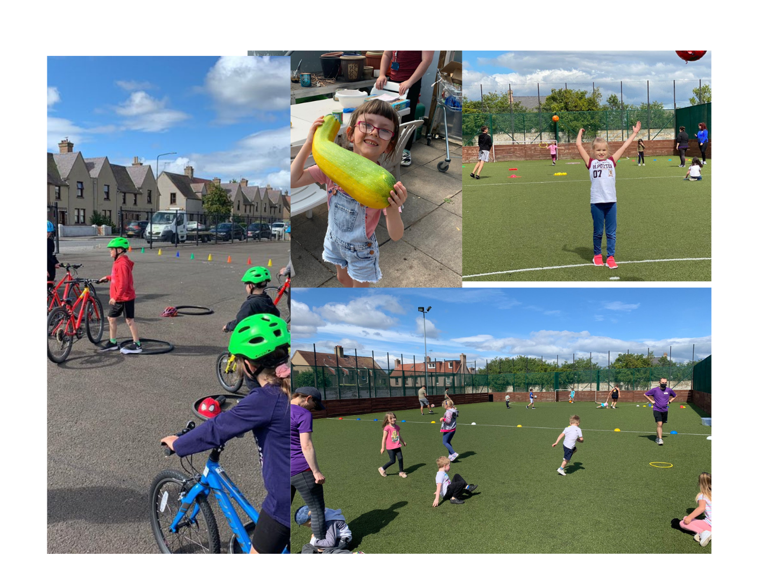
Holiday Provision and Lunch Clubs £40,000
The Pennypit Trust ran activities in;
Summer – for 50 children, limit 10 a day
October – for 40 children, limit 20 a day
February – for 50 children
Port Seton Centre ran activities in Summer for up to 10 children per day
This included bikeability for 40 children who learnt to ride a bike, arts and crafts, park trips, unicorn quest and a packed lunch/recipe pack.

