Slide 1
Local Housing Strategy 2023-2028
Rebecca Pringle – Housing Strategy Team Manager
rpringle@eastlothian.gov.uk

Slide 2

What is the ultimate aim of the LHS?
Demographics
Climate change
Socio-economic status
Housing System
Housing market
The economy
Geographical movement
Health
Cost of materials
Labour market

Slide 3
Local Housing Strategy
Sets out a commitment to joint working
Housing Supply Target – how it will be delivered
Investment in Affordable Housing
Investment in Housing Support Services
Sets out commitment to revise policies in line with national changes
Identifies areas which require more research or data
Notes:
LHS identifies the challenges and opportunities within the County and sets out the strategic priorities for investment in housing and housing related services over a 5 year period. It covers all tenures of housing, and includes homelessness, regeneration, energy efficiency, housing supply, affordable housing and particular needs housing. It is underpinned by a number of key research documents.
A strategic document which sets out the challenges and opportunities for housing and housing related services across tenures, over a 5 years period.
It informs investment and puts forward a range of actions to be achieved by a range of council services and RSLs.
Aligns with Scottish Government policy i.e. Housing to 2040 but also local policies i.e. poverty plan, equality plan etc.
Communities & town centres; affordable housing; house conditions; energy efficiency & climate change; homelessness; specialist housing; housing supply

Slide 4
LHS Prep
South East Scotland Housing Need and Demand Assessment
Housing Supply Target
Joint Strategic Needs Assessment Specialist Provision
Local Housing Systems Analysis
Consultation & Engagement
Draft LHS

Slide 5
LHS Prep
South East Scotland Housing Need and Demand Assessment
Housing Supply Target
Joint Strategic Needs Assessment Specialist Provision
Local Housing Systems Analysis
Consultation & Engagement
Draft LHS

Slide 6
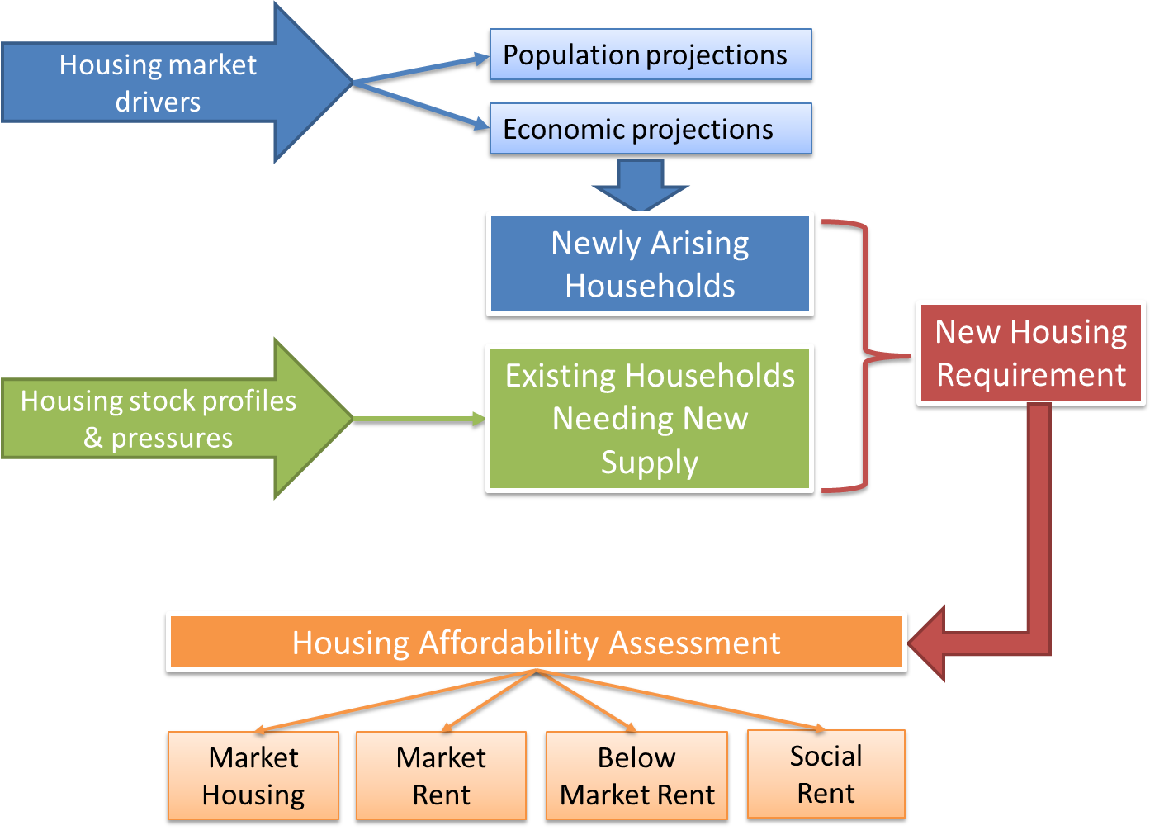
The HNDA Toolkit
Newly Arising Households
Created by the Scottish Government
Contains data for all local authorities in Scotland, can report on a local authority and HMA level.
Default figures from NRS on population and household projections.
Key inputs into the toolkit are:
  Housing projections
  Existing need
  Income profile: growth and distribution
  Prices and affordability
  Split need by tenure
New Housing Need

Slide 7
LHS Prep
South East Scotland Housing Need and Demand Assessment
Housing Supply Target
Joint Strategic Needs Assessment Specialist Provision
Local Housing Systems Analysis
Consultation & Engagement
Draft LHS

Slide 8
HNDA 3 Output – East Lothian
We have received 8 recommendations from the Scottish Government. We have to meet these before it’s signed off as robust and credible.
HNDA3 gives us estimates and scenarios with which we can base our Housing Supply Target on.
A Housing Supply Target is the number of affordable homes which can be delivered over the next 5 years. This has to take into consideration all the legislative constraints, the East Lothian land context, and the economy.
We will work with our South East Scotland partners to develop a methodology to develop Housing Supply Target, which will then be presented in the LHS.

Slide 9
LHS Prep
South East Scotland Housing Need and Demand Assessment
Housing Supply Target
Joint Strategic Needs Assessment Specialist Provision
Local Housing Systems Analysis
Consultation & Engagement
Draft LHS

Slide 10
JSNA – Specialist Provision
Identify the need and demand for a specific type of housing
Identify need and demand for housing support service
Commitment to number of properties per year
Recommendations to changes in housing policy, processes and joint-working.
Recommendations for training, awareness and participation.
Recommendations if approved become LHS actions, reported on yearly to Cabinet and Scottish Government.

Slide 11
LHS Prep
South East Scotland Housing Need and Demand Assessment
Housing Supply Target
Joint Strategic Needs Assessment Specialist Provision
Local Housing Systems Analysis
Consultation & Engagement
Draft LHS

Slide 12
2022
2023
Revise &Final LHS to cabinet & Scottish Government
Compile Evidence & Present Evidence
Community Housing & Homelessness Workshops
Draft LHS to cabinet
JANUARY - FEBRUARY
APRIL
JUNE-AUGUST
APRIL - JUNE
OCTOBER
MAY
SEPTEMBER- DECEMBER
MARCH
JULY - SEPTEMBER
Equalities Workshops
Write Up & Approval
Approved LHS
Public Consultation
Area Partnerships, Community Councils, Community groups and lived experience.
V
ONLINE SURVEYS
TARGET WORKSHOPS
WALKING CONSULTATIONS
VCEL CONFERENCE

